Slide 1
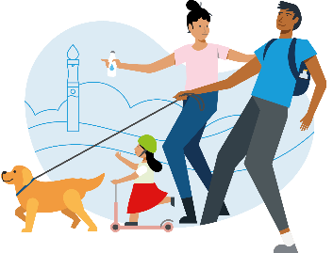
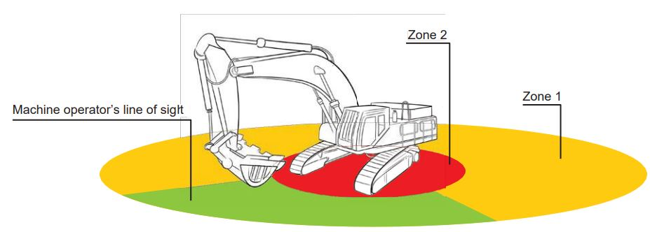
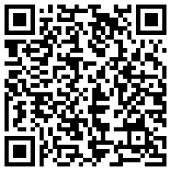
Life Saving Commitments
People, Plant & Interface
Thames Water and its Partners carry out thousands of activities each year; construction, streetworks, tankering and deliveries. Hazards associated with these activities can cause risks to our colleagues and customers. People / Plant Interface is recognised as one of the key fatal risks within construction and features in most sites top 5 safety risks.
Key issues are:
Hierarchy of Control
Competence
Suitable and Sufficient Safe Working
Zones
Thames Water have several Standards that have been developed with our Partners to assist in developing your Safe Systems, or Work Risk Assessments and planning work activities. They can be found on the Health & Safety Hub in the Key documents section - http://www.healthandsafetyhub.co.uk/index.html
In Particular, for People, Plant & Interface please refer to:
Essential Standards:
No.1 – Excavations
No.6 – Mobile Plant
No.14 – Safety in Vehicle Movements
No.15 – Protecting the public during Temporary Work Activities
No. 21 – Large Commercial Vehicles on Public Highways and Construction Sites
NRSWA – Safety at Streetworks and Road works ACOP
Thames Water Visual Standards
It is everyone's responsibility to protect the public

Slide 2
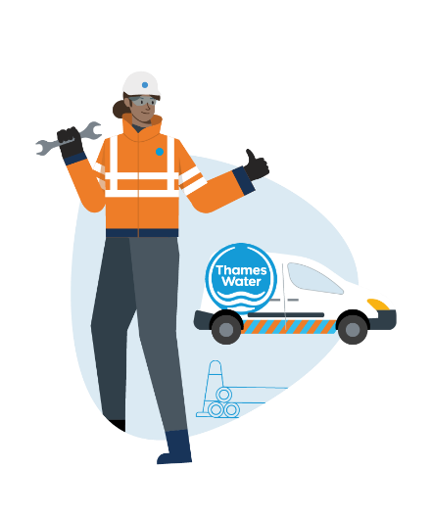
Life Saving Commitments
People, Plant & Interface
Planning your site safely and monitoring activities and the environment are key to being in control and protecting those around us. Have you considered the following on your site?
Key Controls:
Ensuring the plant is suitable and appropriate for the task by considering the ground conditions, current hazards on site, safe access and egress, visibility of the driver, driver protection, specification and arrangements for maintenance.
Careful thought and planning of the work activity must take place when there is a risk of working within the exclusions zones.
Ensure the plant is maintained, inspected and fit for purpose.
Conduct regular machine and plant checks, especially before use.
Ensure that all plant, machinery and equipment are immobilised and secure when not in use. Always remove the keys, lock away and secure any barriers
Ensuring drivers and gangers are trained, competent and confident to undertake the task. Confirm they are familiar and aware of the correct use of the vehicle, it’s limitations and hazards if not properly used.
Banksmen need suitable and sufficient training to ensure they are confident in directing pedestrians and vehicles.
Clear communication regarding the machines working zones and exclusion zones. People are at most risk when behind or in the swing radius.
Always approach the working zones with extreme caution and get the plant operators attention. A “thumps-up” is a universal sign that something is “ok”.
Be aware of changing environments. Ensure a robust monitoring regime is in place to prevent mobile plant from overturning or falling in.
Ensure risks that are introduced by the plant, such as items falling from height, are considering during the planning phase and are suitably controlled by the RAMS and SSOW.
Review new ways of working and newly developed technology E.G. Proximity sensors and 360 degree cameras
When working in and around the public, always remember ZERO Compromise

Slide 3
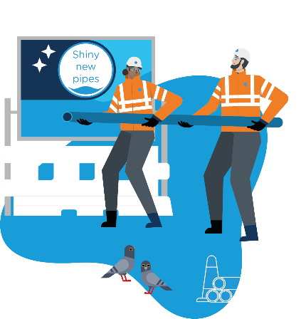
Life Saving Commitments
People, Plant & Interface
Hierarchy of Control;
Eliminate the risk: by fencing off the area
Minimise the risk: Establish full or partial segregation, such as barriers or marshals. If people do have to work immediately adjacent to plant, establish clear controls and communications between workers and plant operators
Suitable and Sufficient Safe Working Zones; Where people are at most risk behind the plant or in the swing radius of the excavator, the activity must be subject to a risk assessment with identified control measures put in place to ensure the task
is conducted safely
Competence; ensure everyone is trained, competent and confident at undertaking the task in hand. Everyone working in the area must understand the risks involved in the task and the emergency procedures.
We can ALL help to create a safe environment to protect the public

