Slide 1
Capital Delivery
People Plant Interface Campaign
January 2023

Slide 2
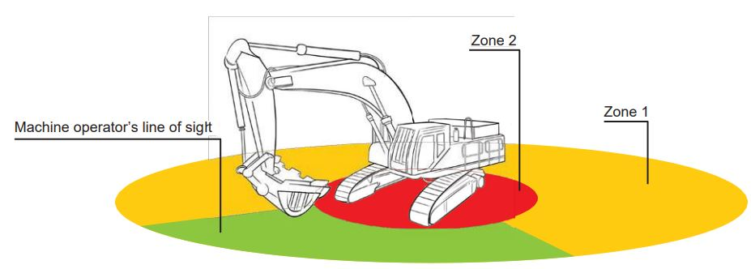
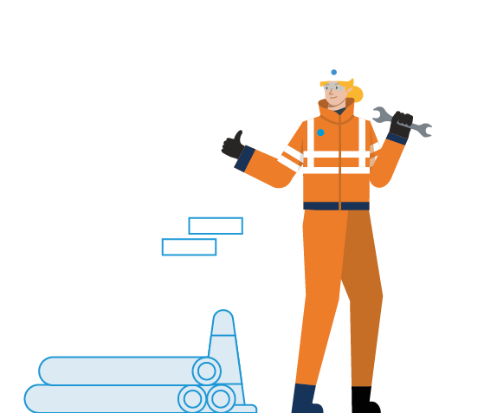

PPI Campaign
Who is the campaign for and why?
This is our 3rd 6month Campaign within Capital delivery following on from the previous successful campaigns (service avoidance and excavation’s). Our previous campaigns were led on lagging data, and this will be our first pro active campaign around People Plant Interface and the associated hazards
Situational Awareness plays are huge part in this campaign and is incorporated with the documents.
The campaign is aimed at everyone within Capital Delivery, not just workers but anyone who is present on site (including office staff). As we return from the festive break and finalise year 3 we have significant ramp up in productivity, it is critical we don’t lose track of the importance of keeping everyone safe
Notes:
This to give them a introduction to the campaign,
The first few slides are the back ground and understanding
Within the pack is designed so you can tailor it to incorporate your own twist/slogan but still incorporating the key messages we want you to share.
Summary and learning from incident
Pack will be shared on Monday and available on the Hub on Monday
Rolled out initially within CD – UMWG aware with plans to roll out in Feb and rest of BAU who break ground.
Situational Awareness launched in October 2021, initial this is what it is, this is what to do. Further comms (e-learning and exercise during Feb 2022).

Slide 3
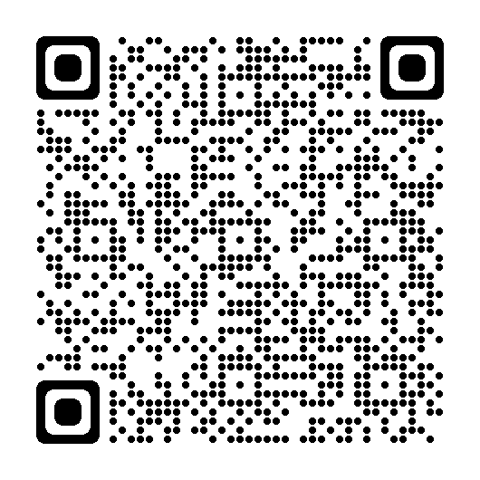

A message from Francis
PPI Campaign
Francis Paonessa, Director of Capital Delivery Safety Message
Notes:
This to give them a introduction to the campaign,
The first few slides are the back ground and understanding
Within the pack is designed so you can tailor it to incorporate your own twist/slogan but still incorporating the key messages we want you to share.
Summary and learning from incident
Pack will be shared on Monday and available on the Hub on Monday
Rolled out initially within CD – UMWG aware with plans to roll out in Feb and rest of BAU who break ground.
Situational Awareness launched in October 2021, initial this is what it is, this is what to do. Further comms (e-learning and exercise during Feb 2022).

Slide 4
PPI Campaign
So what is the real issue?
Stats HSE
80 Members of the public were Killed as a result of a construction related incident between 2021 and 2022
In 2021/22 struck by moving vehicle was the 2nd highest reason for fatal incidents (23)
In 2021/22 there was 15 deaths due to contact with moving machinery
With a significant increased work load predicted for 2023 and year 4 of our AMP, plant interface is expected across all our projects and work that we undertake in Capital Deliver. This includes, but not limited too: Mains Rehab, Trunk Mains, Sewer rehabilitation, Tunnels and Aqueducts, and Pressure management,
Given the work increase, we estimate plant movements to be approximately 20,000 per year, which all carry associated inherent risks with potential to cause significant injury to work force or the general public
Statistics taken from the Health and Safety Executive give a chilling insight as to why this is such a high profile risk and should be appropriately managed at all levels.

Slide 5
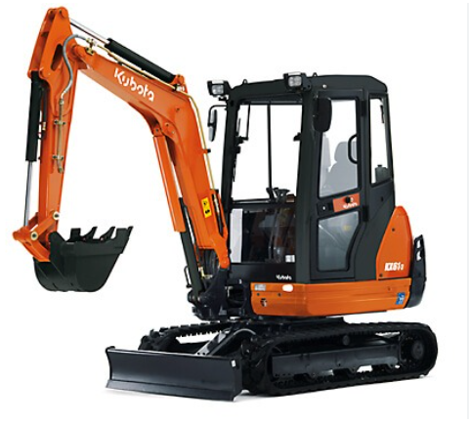
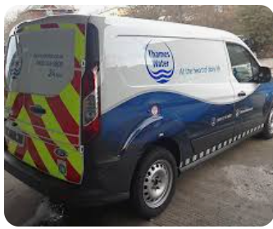
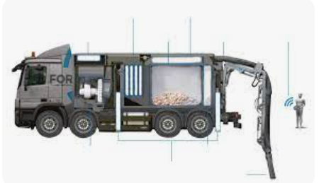
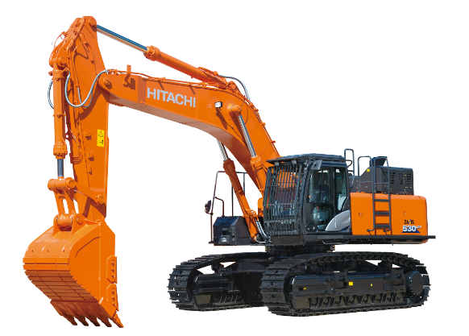
What is “Plant”?
Do you consider all plant, or just the big stuff?
Plant interface is all around us on a site, not just the big excavations or heavy machinery. Even if we don’t operate the big machines, our interface with it must be considered and risks eliminated where possible.
The majority of our areas will be on live operational Thames Water sites, so we must consider and take into account that OP’s may be driving around us, not just in their transport vans but also in large tankers. It’s very easy to slip into alpha mode and just consider the construction risks within our control.
Be aware and ensure all plant movements are considered within the SSOW, if in doubt, stop work and reassess the risk!

Slide 6
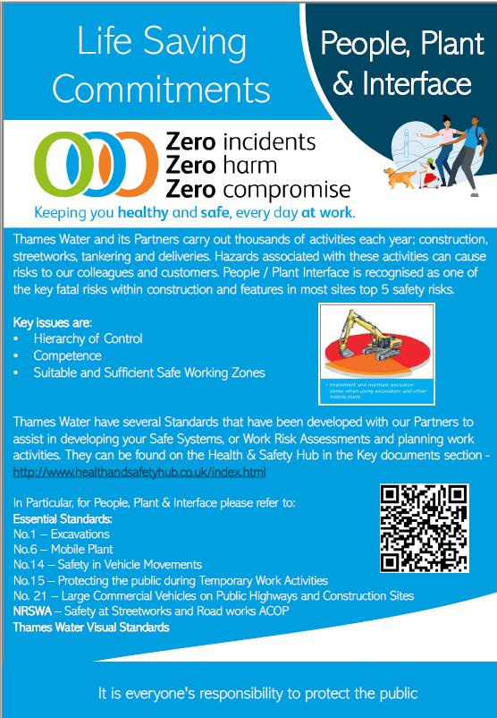
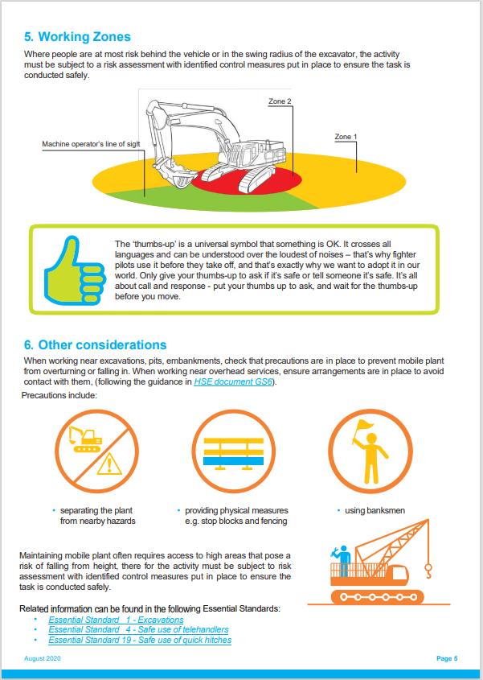
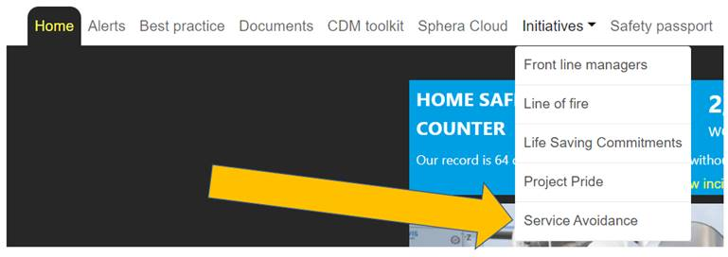
Tools
Material / Resources available for this campaign
Health and Safety Information Document
Developed with Business Partners
H&S Hub - Health and Safety Hub
PPI Checklist
Guidance Notes added
Spheracloud Checklist
Essential standards
No.1 – Excavations
No.6 – Mobile Plant
No.14 – Safety in Vehicle Movements
No.15 – Protecting the public during Temporary Work Activities
No. 21 – Large Commercial Vehicles on Public Highways and Construction Sites

Slide 7
What’s Next?
We need your commitment…
Senior Managers to hold a Safety Stand-down(s) with your teams and brief them on the PPI campaign
Undertake the target audit to capture compliance and actions – Recorded onto Spheracloud
Review plan and feedback any improvements
The following slides have been designed for you to use as a template and allow you to tailor them to capture your own organisations strap line as well as to ensure we all have a consistent message.

Slide 8
PPI Campaign
Team stand down pack
January 2023

Slide 9

People Plant Interface Campaign
January 2023
We are steadily increasing our workload across the framework, with approximately 20,000 plant movements a year expected!
Serious injuries have occurred from not following simple processes or procedures
Through investigation of these incidents it has been found that most (if not all), could have been prevented if the basics had been implemented.
These standards and processes are there to keep you safe and if you can’t apply what your safe system of work or method is asking, STOP work and speak to your supervisor.
ALWAYS assess the task thoroughly using your permit(s), prior to starting work and apply any hold points identified

Slide 10
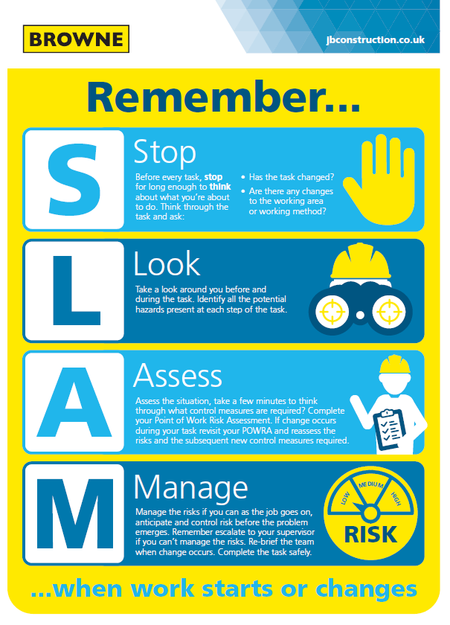
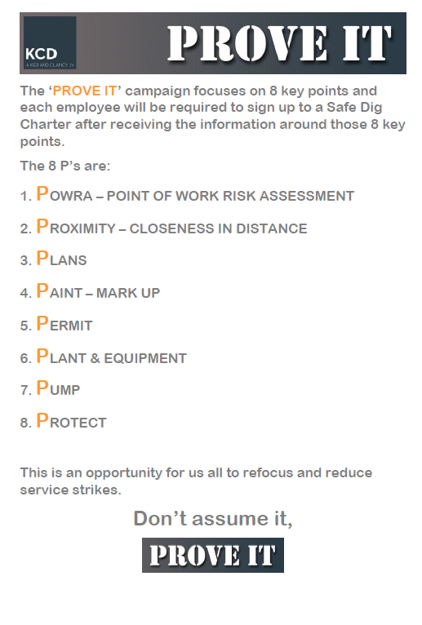

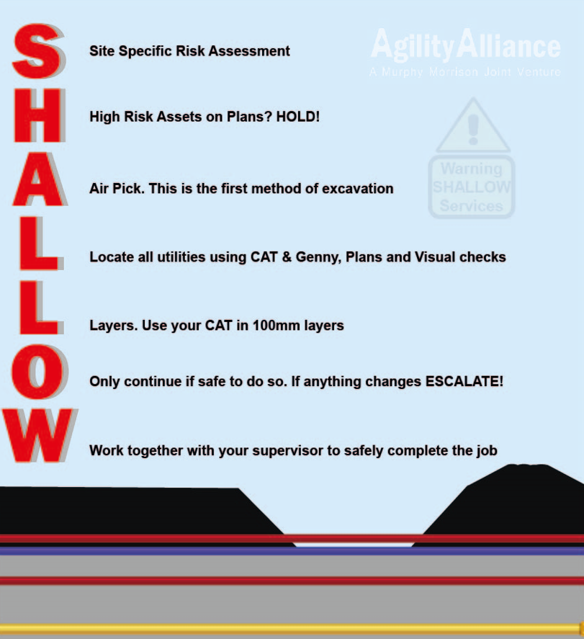
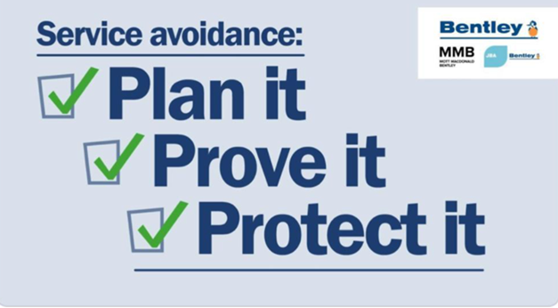
Keeping you safe
Add your own straplines here and make it specific to your teams

Slide 11
Innovation – New ways of protecting people
Add here what your business is doing to protect people

Slide 12
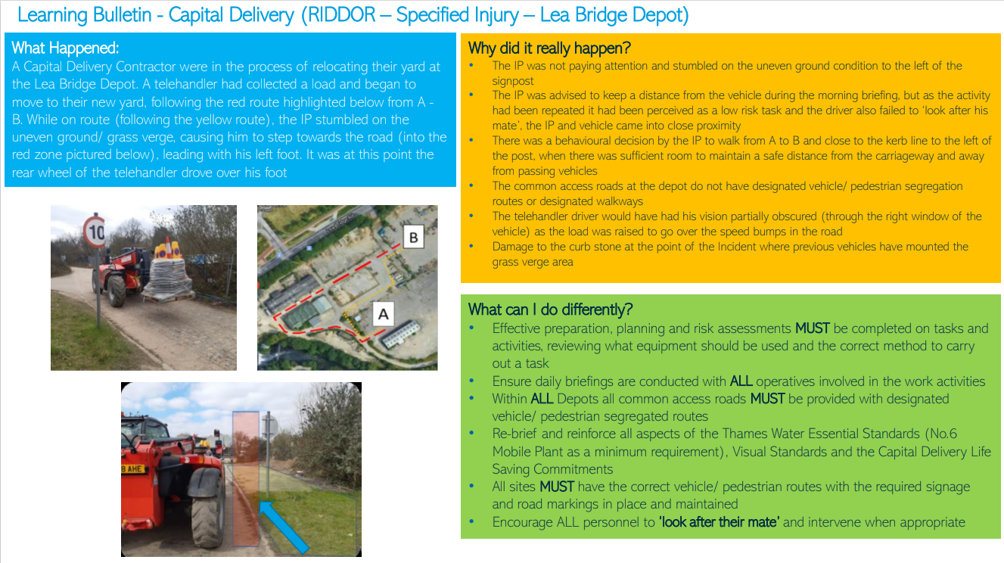

Slide 13
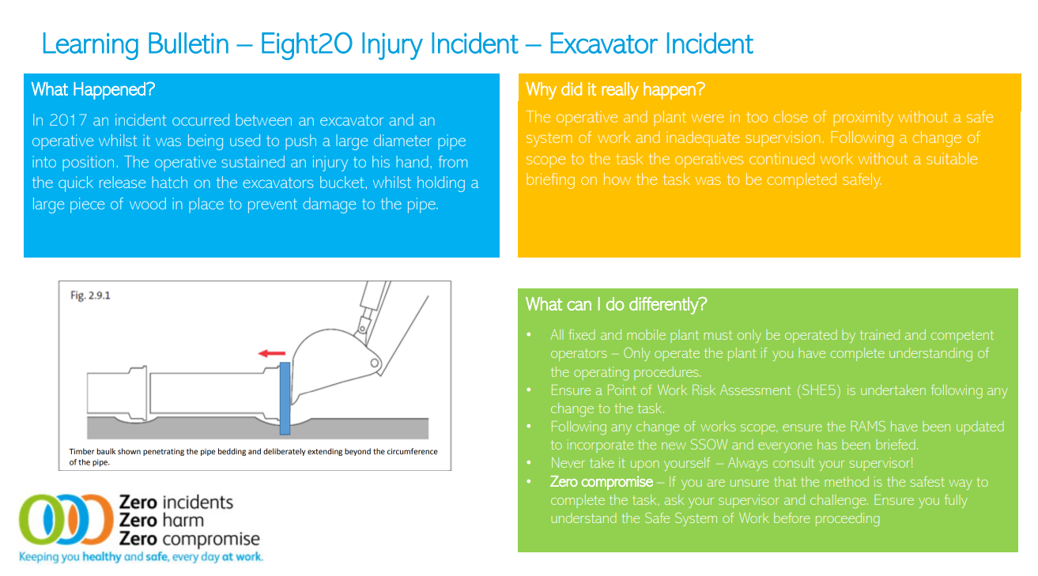

Slide 14
People Plant Interface
Shared learning
People Plant Interface Life Saving Commitment Video
Safety At Roadworks
Press CTRL and click on the above link to play the video

Slide 15
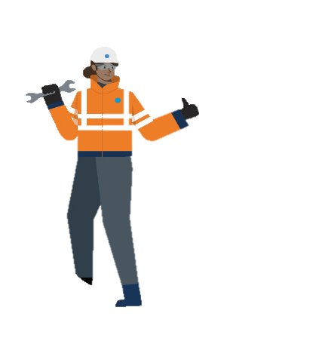
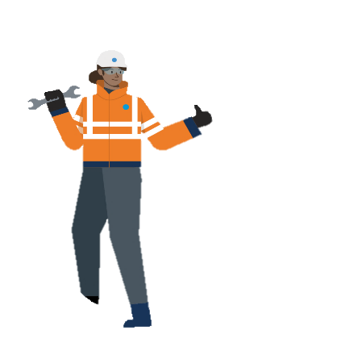
Situational Awareness
Remember to use your senses!
3m
Identify best safe position to stop
From inside the vehicle visually check the first 3m radius
Look down firstly, if no hazards step out
Complete a visual 3m radius check from ground to up and above head height.
Complete a physical check only in the 3m radius
10m
Only to be done once 3m checks are complete
Visually check the 10m radius
Once visual check is complete, do a physical check of 10m radius
Secondary
Immediate
10m
3m
3m
10m

Slide 16
What do we want from you?
Your commitment to:
Ensure you have suitable and sufficient SAFE working zones:
  ALWAYS approach the front of any mobile plant, so the operator can clearly see you
  Ensure exclusion zones are clearly identifiable
  Never enter the “RED” zone unless you have acknowledgement from the operator of the plant
  Use the “Thumbs up” universal sign
  Use a banks person
STOP work and ALWAYs speak to your supervisor if:
  You are unsure of the Safe System of Work
  You feel you are not competent to undertake the task
  You are unsure of the hierarchy of control
  You do not have a clear exclusion zone for workers AND members of the public
Only use plant that is suitable for the task
Always undertake your pre use mobile plant checks
Always wear appropriate PPE
Ensure you fully understand the task and activity

Slide 17
Any Questions?

Slide 18
Thank You

