Slide 2
Service Avoidance Campaign
Agenda
Introductions:
Service Avoidance Campaign.
Project Pride:
Sphera Workshop
Sphera Statics
Q&A Session:
Notes:
Introductions: We will begin the event with introductions to familiarise everyone with the key members involved in the campaign. Service Avoidance Campaign:
We will unveil the details of our Service Avoidance Campaign. which aims to raise awareness about the importance of avoiding unnecessary services and focusing on sustainable solutions. We will share the campaign's objectives, strategies, and the positive impact it can have on us all Project Pride:
Project Pride: Following the campaign presentation, we will highlight our achievements through the Project Pride initiative. This segment will showcase the efforts and accomplishments of our dedicated team, recognising their contributions towards promoting sustainability within our works.
Sphera Reporting Workshop:
Sphera Workshop: in this interactive workshop, we will dive into the functionalities of Sphera, our latest reporting tool. The workshop will provide valuable insights into using Sphera effectively, empowering our team members to understand the requirements of reporting. Sphera Statistics:
Sphera Statics: Our current statistics and trends generated by Sphera comparing strike data
Q&A Session: we value your input and would like to address any questions or concerns you may have. We have allocated dedicated time for a question and answer session, where our experts will be available to provide detailed responses and engage in fruitful discussions

Slide 3
Service Avoidance Campaign Re Launch
July 23

Slide 4


Service Avoidance Campaign
Who is the campaign for and why?
Anyone who carries out a task that involves breaking ground is at risk of striking a service, and in some cases suffer from physical injury or lasting emotional distresses from the experience, and we want to do everything we can to reduce the potential of this.
We have developed this campaign to raise awareness of the growing concerns, signpost what information is available to you and help to create a discussion with your teams.
This campaign also wants focus on the design stage looking at how we manage service avoidance at this stage
We ask that you take the time to discuss the slides with your teams, and have your commitment to using the tools we have developed for you to implement and assist in improving our standards.
Notes:
This to give them a introduction to the campaign,
The first few slides are the back ground and understanding
Within the pack is designed so you can tailor it to incorporate your own twist/slogan but still incorporating the key messages we want you to share.
Summary and learning from incident
Pack will be shared on Monday and available on the Hub on Monday
Rolled out initially within CD – UMWG aware with plans to roll out in Feb and rest of BAU who break ground.
Situational Awareness launched in October 2021, initial this is what it is, this is what to do. Further comms (e-learning and exercise during Feb 2022).

Slide 5
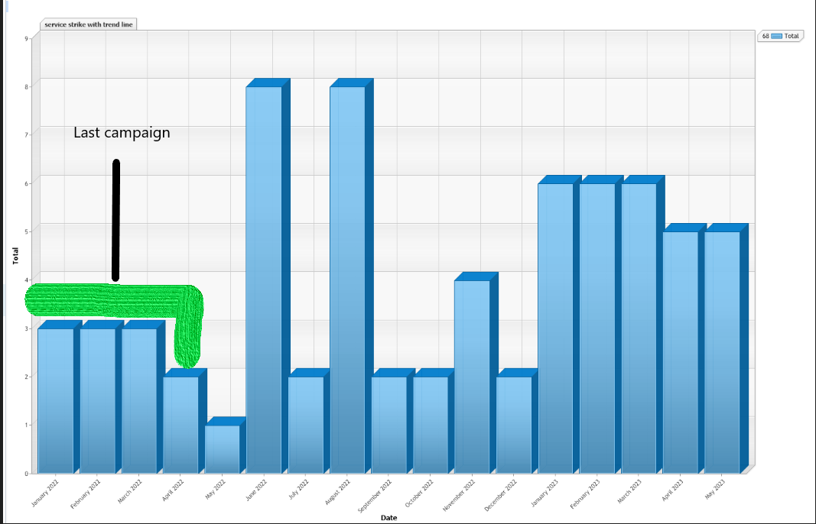
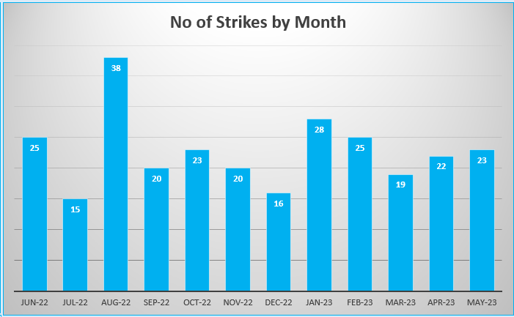
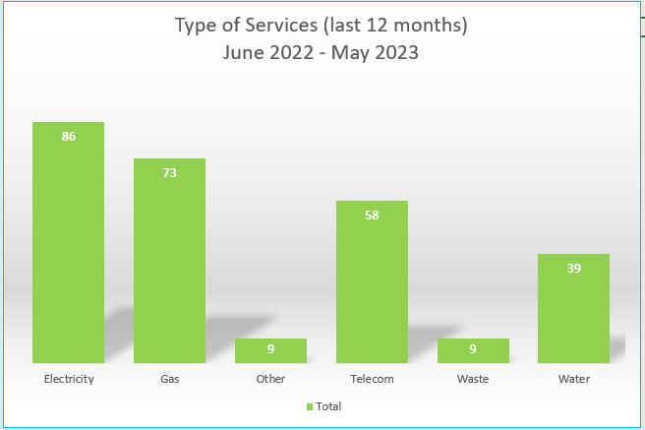
Service Avoidance Campaign
Why are we Re-Launching
Over the past AMP, we have seen a 20% decrease in services being struck. However, in the past year service strikes are increasing, especially those with the potential to cause harm
Through investigation of these incidents it has been found that most (if not all), could have been prevented if the basics had been implemented prior to any breaking ground commencing
  The basic requirements can be found in the HSE guidance - HSG47 and the Thames Water Essential Standards 1 & 27
To reduce the likelihood of another injury which could be significantly worse, we must reduce the services being struck and improve the standards of the teams carrying out any activity that involves working around potential services and breaking ground
During the last campaign we dramatically reduced Service Strikes but the trend is showing an increase as per the top graph, Green highlight is the previous campaign

Slide 6
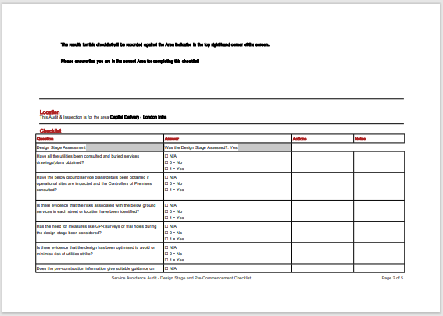
Tools
Material / Resources available for this campaign
Service Avoidance Checklist (site focus)
Guidance Notes added
Spheracloud Checklist
Service Avoidance Checklist (Design Focus))
Guidance Notes added
Spheracloud Checklist
Service Avoidance
Contractor Name: |  |  | Auditor:
On site contact: |  |  | Date:
Project name / code:
Location:
Guidance Notes: Remember this audit is purely on Service Avoidance - There will be several other aspects of work involved in the activity. Where any excavation or breaking ground is occurring, service avoidance comes into play. It is essential that the dig team are trained, competent and using safe digging practices to avoid any known or unknown services. A Genny is a device that inducts a signal into underground services which then can be picked up via a CAT, a Genny is a small box and can either be connected to a pipe or can be placed on its side to induct a signal into the ground. A CAT is a hand scanning device and has 3 modes, all 3 modes must be used when scanning for services. Prior to any excavation or ground breaking, the team must have utility drawings which will show any known services in the area. Surveys such as Ground Penetration Radar (GPR) may also be present which will give the team an idea of what's below the ground. It is important to know that drawings are just a guide and not 100% accurate and the team must not solely rely on them, therefore trial holes may be dug to identify high hazard services to prove or disprove the utility drawings and GPR. Once all known services have been positively identified it is important for the team to mark them up, this is done via coloured spray paint and is a visual reminder for the dig team. Even if there is no known services in the area the dig team must rescan using the GEN & CAT at every 150mm dug, this is in accordance with Essential Standard 1 and HSG47 Safe Digging Practices. With regards to any machinery or equipment you will want to be looking for any defeats and ensuring that it is in good condition, this will includes any hand tools, rotatory equipment and any mobile plant. Although it will not prevent a service strike, the dig team must be in Flame and Arc resistance PPE and using fully insulated dig tools.g team must be in Flame and Arc resistance PPE and using fully insulated dig tools.
 | Questions | Compliant Y/N/NA? | Comments | Actions required
1 | Are the dig team in possession of TWUL Passport?
2 | Are personnnel who are using the detection equipment trained to Level 2 Gen and Cat?
3 | Are utility drawings on site and do they identify all known services? Water, Gas, Low Voltage, High Voltage, Telecomms (Virgin, BT)?
3a | Are the utility drawings readable and have they been accessed prior to work starting (documented on site or recorded on a tablet)
4 | Is the Gen and Cat calibrated and within date? (The onsite team should have a certificate to prove the calibration date), one for the Cat and one for the Genny
4a | Does the CAT & Genny meet TW minimum standards, ie CAT 4
4b | Is there evidence that all 3 modes have been used when scanning for services, either on site or on CAT manager
4c | Does the contractor monitor the gangs use of CAT & Genny and highlight any improvements / good practice
5 | Have any trial holes been undertaken to identify high hazard services? (Trial holes are small excavatios to prove or disprove a services depth)
5a | For a directional drill, has the depth of all services been adequatley recorded and is there written evidence for any assumptions made where a trial hole wasn’t undertaken (ie multiple house services)
6 | Do the site team have access to Thames Waters Essential Standard 1 and Health and Safety Guidance 47 (Safe Digging Practices)?
7 | Is there a Permit to break ground/Permit to dig in place prior to work commencing? (Check the date of the permit was issued, the duration of the permit and that it has been signed by relevant persons)
7a | Does the permit clearly identify hold points for issuing a permit to dig or drill ie CAT & Genny survey undertaken
8 | Have the dig team received a briefing on the works Method Statement and associated risks? (What are the control measures or mitigations in place for those hazards identified)
9 | Are known services clearly identified and marked up? (Different coloured Spray paint will be used to identify the direction of services). There must be a process for remarking as the paint fade or becomes unreadable
10 | Is there a non working supervisor overseeing the works/activity?
11 | If an excavator is being used to dig, has it had a daily inspection and can the associated paperwork be provided to confirm it has had it's plant checks?
11a | If an excavator is being used, is their a trained and competent banksman in place
Overall comments:

Slide 7
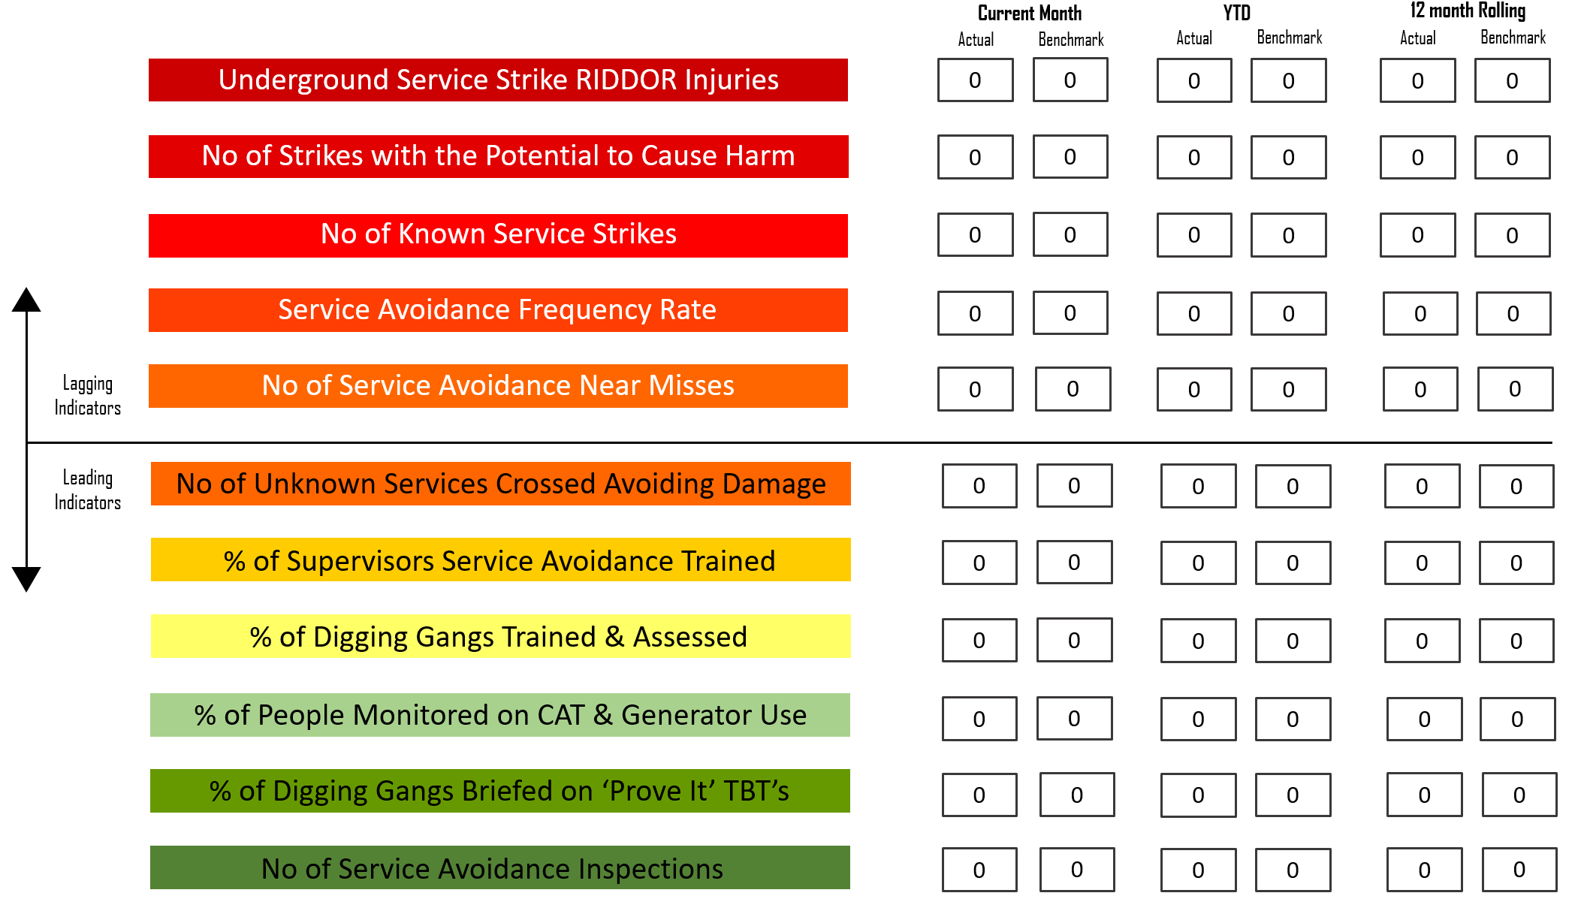
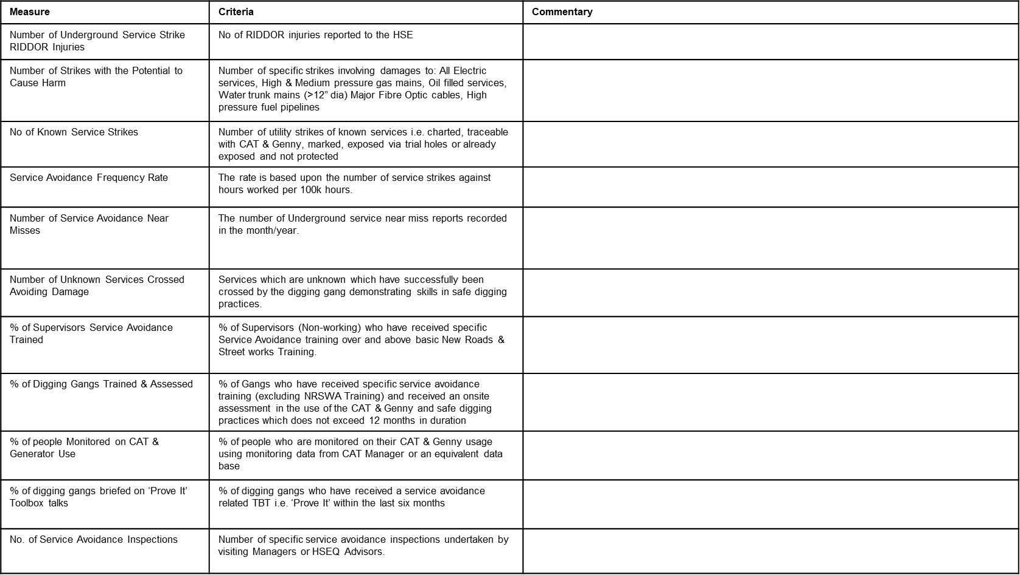
Tools
Material / Resources available for this campaign
Performance Indicator Criteria
Leading and Lagging Indicator Tool

Slide 8
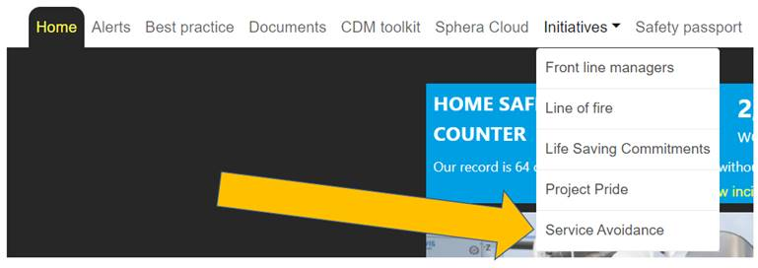
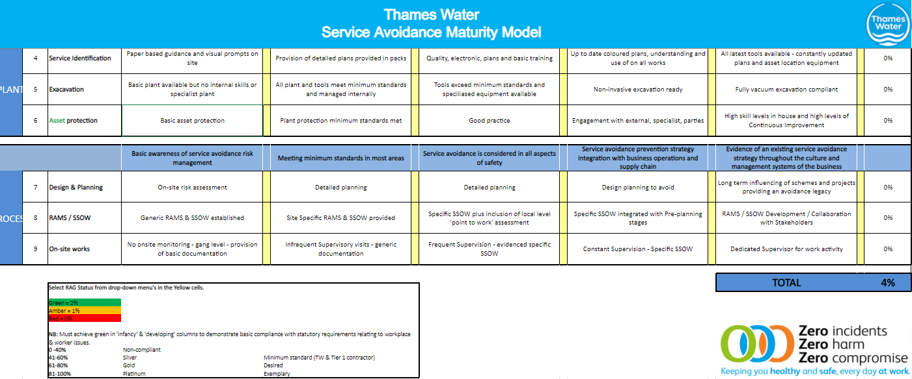
Where can the information be found?
Other material / resources available for this campaign
H&S Hub - Health and Safety Hub
New Initiative – Service Avoidance Campaign
Service Avoidance Maturity Matrix
Service Avoidance Maturity Matrix
Service avoidance leading / lagging indicator tool
Link to Health and Safety HUB
Guidance document on managing directional drilling and moling activities
ETA 31st January 2022
Service Avoidance target audit checklist and guidance
Link to Health and Safety HUB

Slide 9
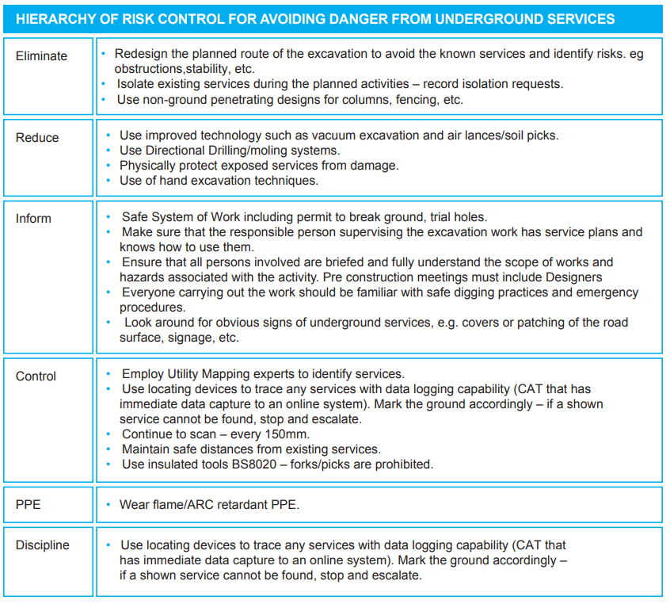
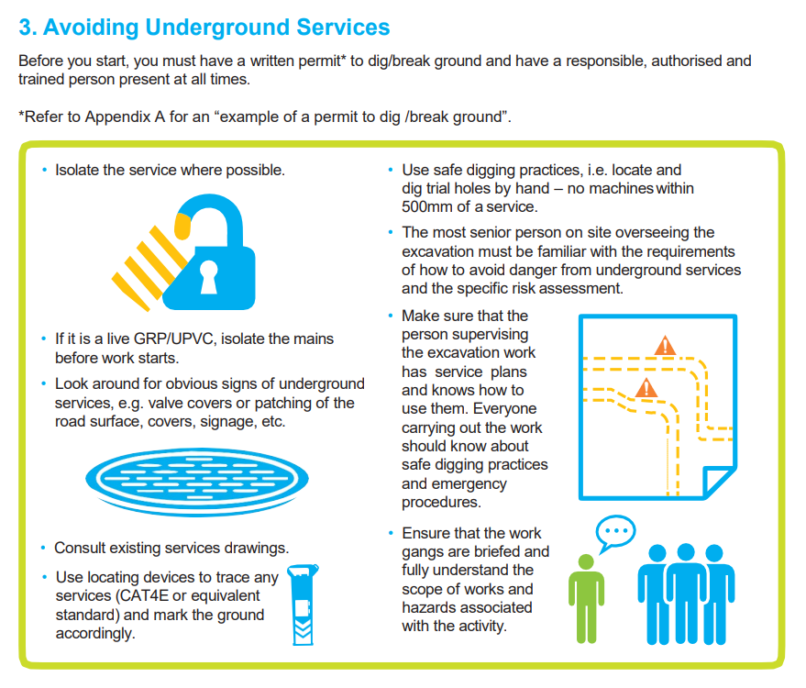


What else is available?
H&S Hub - Health and Safety Hub
Essential Standards 1 & 27.
Thames Water_Issue _Excavation_9 dec.indd (windows.net)
Thames Water_Issue _Utility Management_20 dec.indd (windows.net)

Slide 10

What else is available?
H&S Hub - Health and Safety Hub
Life Saving Commitments - High Hazard Services
Information document on key controls and consideration
Developed an Aide memoire – working near to overhead cables
Making the commitment video - High Hazard Services LSC.mp4 - Thames Water Internal (videomarketingplatform.co)
3 Learning Bulletins from previous incidents
Poster on overhead powerline safety

Slide 11
What’s Next?
We need your commitment…
To implement a Service Avoidance Maturity Matrix and develop your plan for improvement – Completion of the Maturity Matrix to be done by Q1 2022.
Service avoidance target audit and guidance to be used by all to capture compliance and actions – Recorded onto Spheracloud
Letter sent to inform of new mandated service avoidance leading / lagging indicator tool
Guidance document on managing directional drilling and moling activities to be reviewed and embedded when required
Review plan and Evaluate findings
Senior managers to hold Safety Stand-downs – including a design/Pre Construction focused stand-down
The following slides have been designed for you to use as a template and allow you to tailor them to capture your own organisations strap line as well as to ensure we all have a consistent message.

Slide 12
Service Avoidance Campaign
Team stand down pack
July 2023

Slide 13
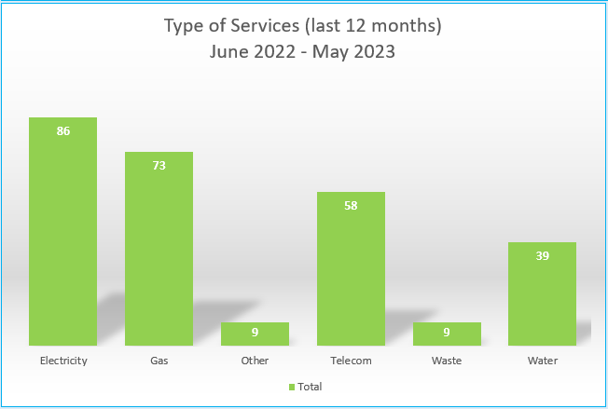
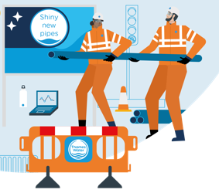
Service Avoidance Campaign
July 2023
We are seeing a steady increase in services being struck over the past few months and more so those that can hurt you!
Thames Water have hit 86 electric services since June 22
Through investigation of these incidents it has been found that most (if not all), could have been prevented if the basics had been implemented prior to any breaking ground commencing
These standards and processes are there to keep you safe and if you can’t apply what your safe system of work or method is asking, STOP work and speak to your supervisor
ALWAYS assess the task thoroughly using your permit to break ground, prior to starting work and apply any hold points identified

Slide 14
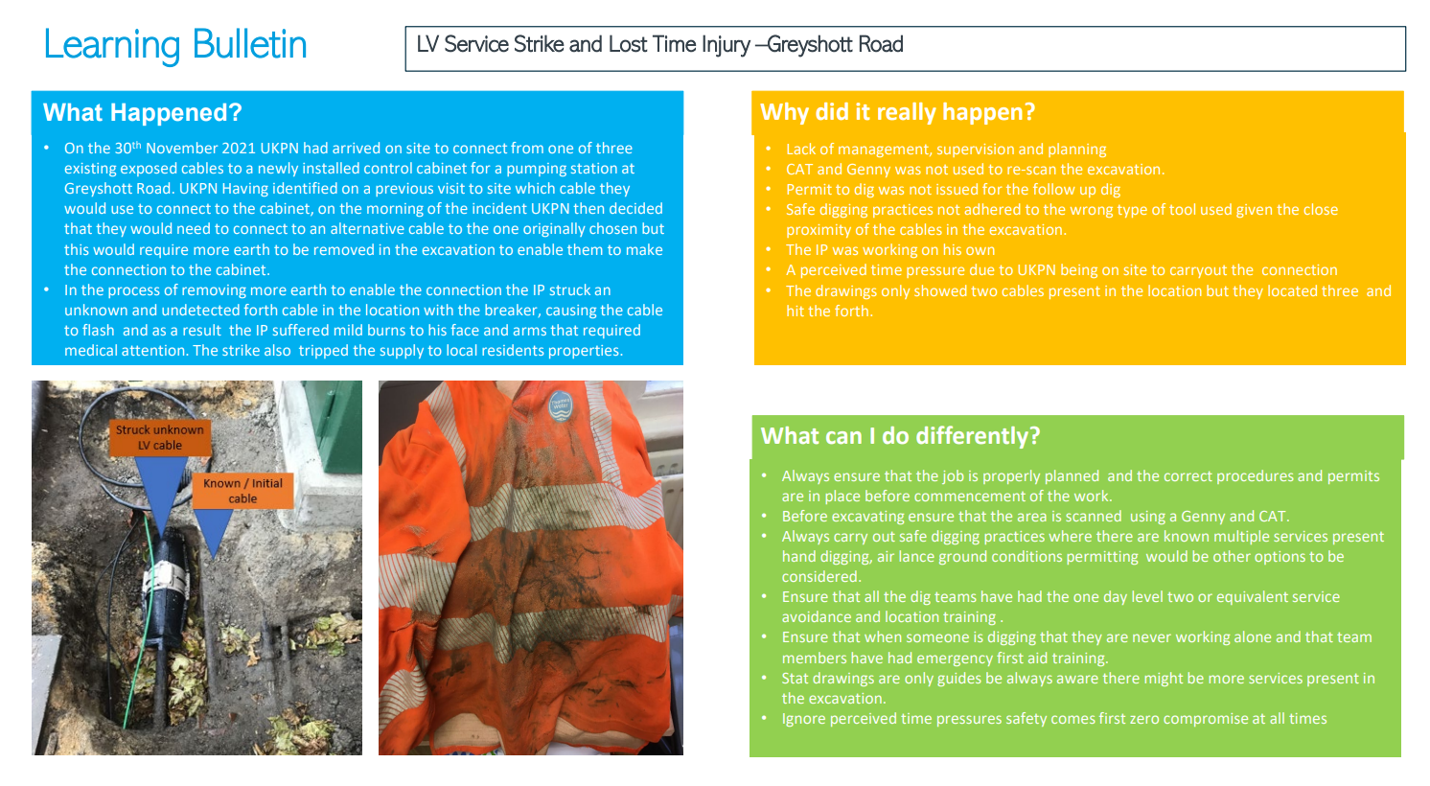

Slide 15
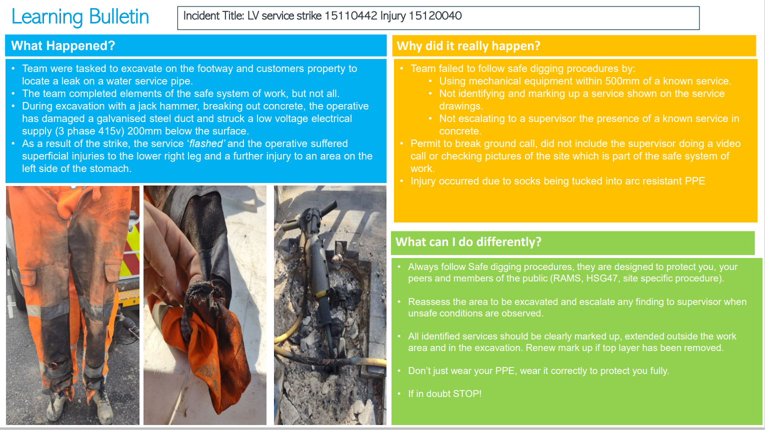

Slide 16
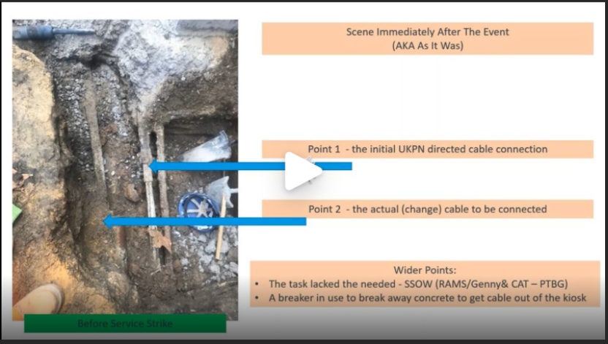
Galliford Try
Shared learning
Service Avoidance Video
Press CTRL and click on the above link to play the video

Slide 17
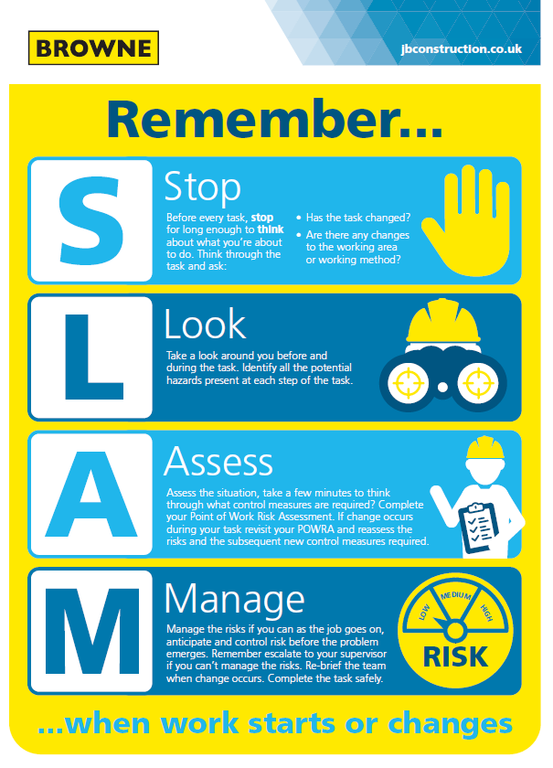
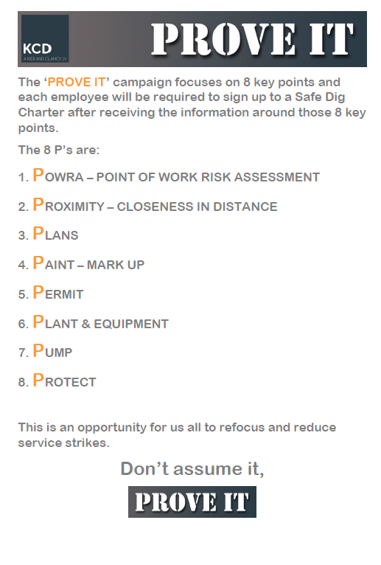

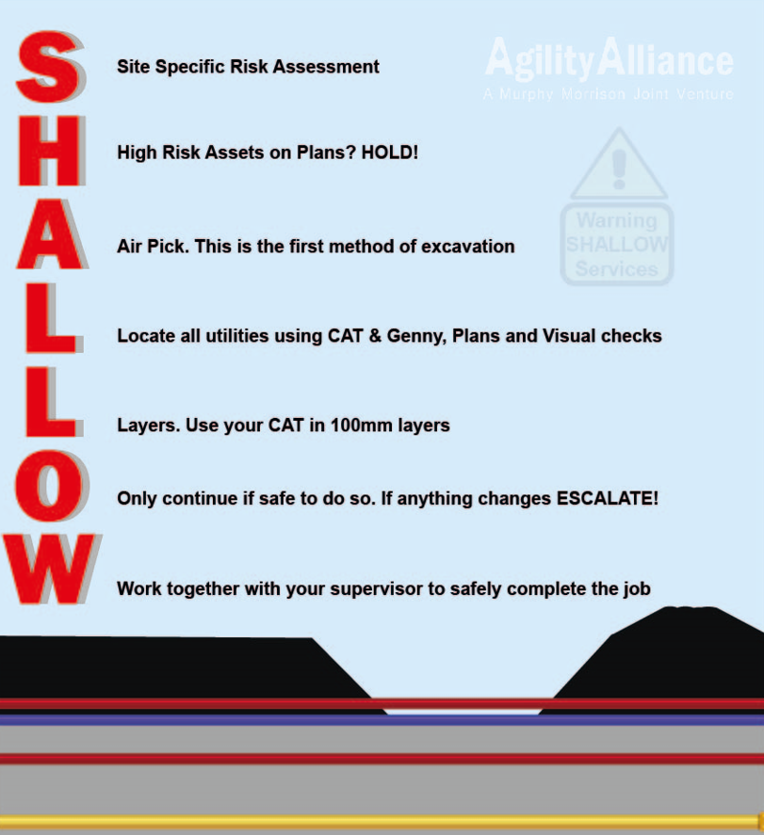
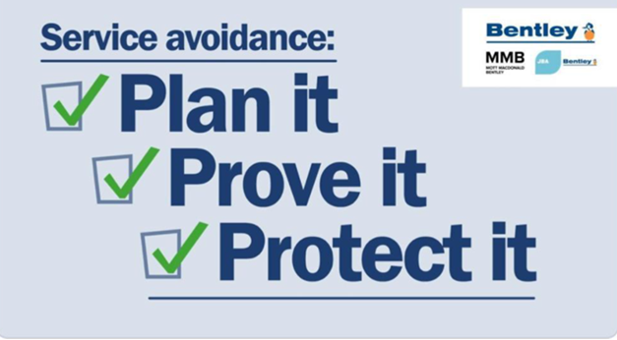
Keeping you safe
Add your own straplines here and make it specific to your teams

Slide 18


Situational Awareness
Remember to use your senses!
3m
Identify best safe position to stop
From inside the vehicle visually check the first 3m radius
Look down firstly, if no hazards step out
Complete a visual 3m radius check from ground to up and above head height.
Complete a physical check only in the 3m radius
10m
Only to be done once 3m checks are complete
Visually check the 10m radius
Once visual check is complete, do a physical check of 10m radius
Secondary
Immediate
10m
3m
3m
10m

Slide 19
What do we want from you?
Your commitment to:
Follow safe digging practices:
  ALWAYS refer to your service plans and ensure they are up to date
  Use your GENNY and CAT before you start to break ground and every 150mm
  Clearly use mark ups, extended outside of the dig area
  NEVER dig directly on top of a mark up/ identified service
  Ensure you protect and support any services exposed
STOP work and ALWAYs speak to your supervisor if:
  You come across a service encased in concrete
  You need to work outside of the agreed permit to break ground
  You are unsure
  You are using a mechanical aid within 500mm of a service
Always follow your safe system of work
Only use a tool/ equipment that has been provided by your supervisor/ storeman
Never Modify your tools to make them easier to use
Only break ground with fully insulated tools
Always wear Flame & ARC PPE
Ensure you fully understand the task and activity - Challenge if you feel the design is flawed or it’s unsafe

Slide 20
Project Pride

Slide 21
Project Pride
Introduction to Project Pride
What Is Project Pride
Who is involved
Who can take part
What is the focus
What are the steps
Step 1: When a site manager, Supervisor, Designer, or team feels that the site has met the requirements of either the gold, silver, bronze standards then they complete a Service avoidance audit checklist and record on safeguard with any actions, images, evidence and good practice etc.
Step 2 :Complete the Service avoidance audit checklist, assess the site against Project Pride requirements, recommend a gold, silver, or bronze award, create a presentation showcasing achievements, register for a SHE7 inspection, receive recommendations if standards are not met, schedule and conduct a SHE7 inspection, provide a debrief explaining decisions and next steps.
Step 3 : Following the SHE7 if successful the site will be award either gold, silver or bronze. A certificate will be presented to the team. If the site has been unsuccessful in achieving gold, silver, bronze then recommendations will be proposed as to how it can improve and achieve the standard. A follow up inspection will be arranged once the actions are completed.
Notes:
What is project pride- Project Pride Award, a distinguished recognition program that celebrates and acknowledges exceptional achievements in line with our Service Avoidance Campaign. This initiative aims to promote and encourage a culture of pride, professionalism, and excellence in all service avoidance works within construction and maintenance projects, ranging from works within treatment, private and public land and let not forget street works.
Who is involved- The Project Pride Award is open to all individuals and teams involved in these diverse projects, irrespective of their scale, location, and position. We believe that every site, regardless of its nature, has the potential to showcase the remarkable dedication and commitment of the people involved in executing their work.
What is the focus- There is an additional focus around designers and their responsibilities, contributions, and importance to a successful service avoidance. A designer responsible for considering and integrating safety into their designs from the outset. This includes identifying and assessing potential risks associated with service strikes, utility clashes, and other hazards that may arise during the construction phase. By taking a proactive approach to risk management, designers can contribute to the overall safety and well-being of the project

Slide 22
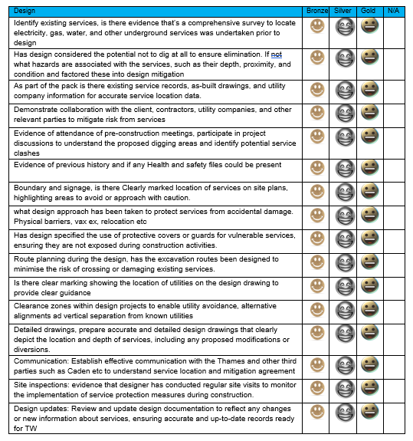
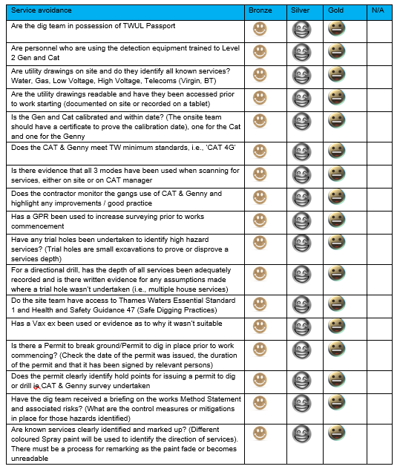
Project Pride
Required Check lists

Slide 23
Sphera Reporting

Slide 24
Incident Reporting and Investigations in SpheraCloud
What makes a good sphera incident report.

Slide 25
What is ‘good’ and why it matters.
A good incident report logged on Sphera
What is ‘Good’…
Includes all available information on the incident, photos statements, Risk Assessments in the right place
Includes any email chains pertinent to the incident.
Photographic evidence of incident site and injuries
Witness statements of injured parties and third parties
Logging of actions resulting from the learning out of the incident
Learning bulletins and toolbox talks added after the investigation reviews
Why it matters…
Allows Thameswater to analyse incidents better within silo’s and look for emerging trends
Standardising our incident reporting between disparate contractor groups
Saves time being wasted chasing incident investigations on sphera by advisors
Meta-analysis of incidents across workstreams and learning across silo’s
Allows for defence in civils claims against TW and contractors

Slide 26
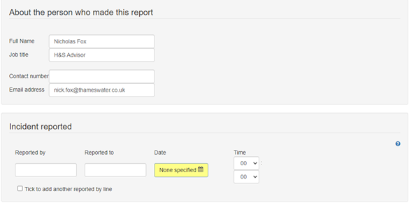
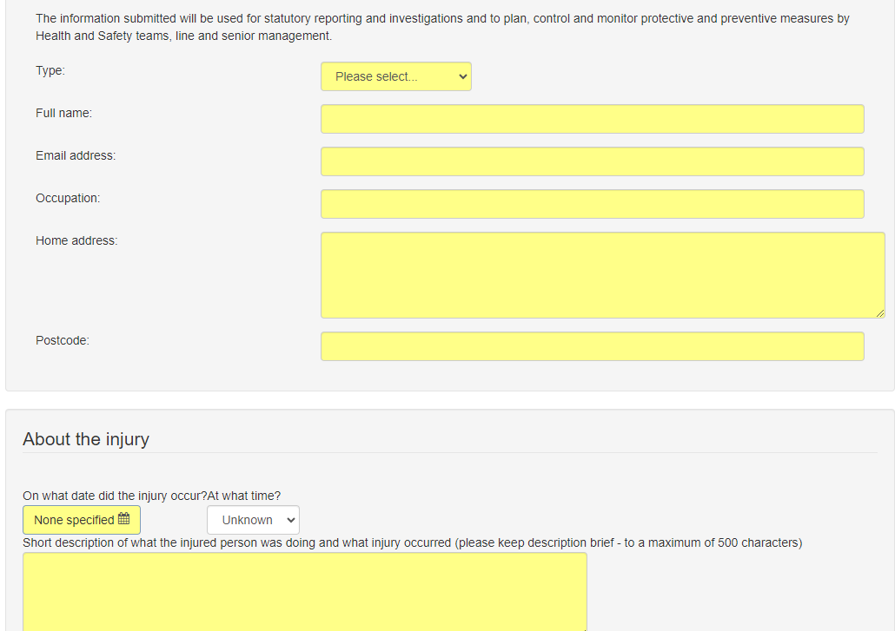
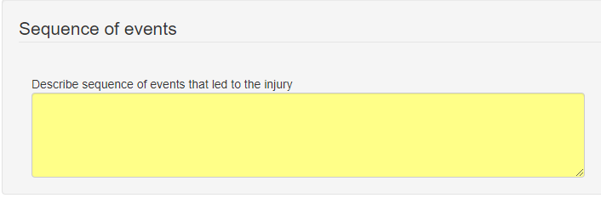
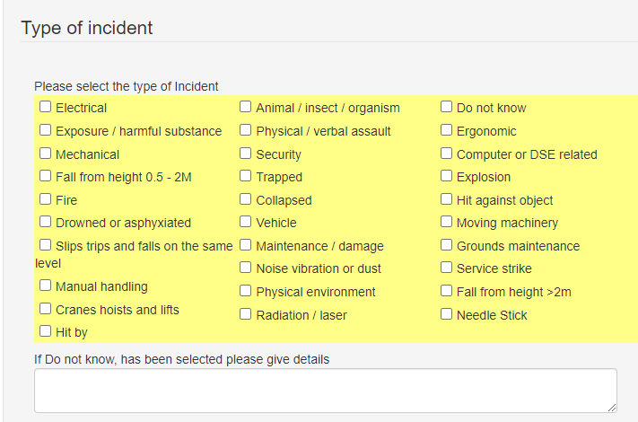
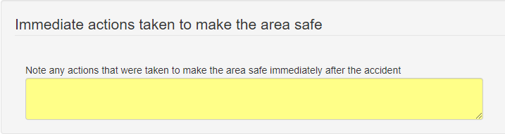
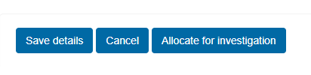
Incident reporting on sphera
Adding incident detail to sphera
Sphera incident report
Incident details
Who, where, when and what has happened.
Immediate information
Not investigation or documentation at this time
Allocate for investigation and create investigation page

Slide 27
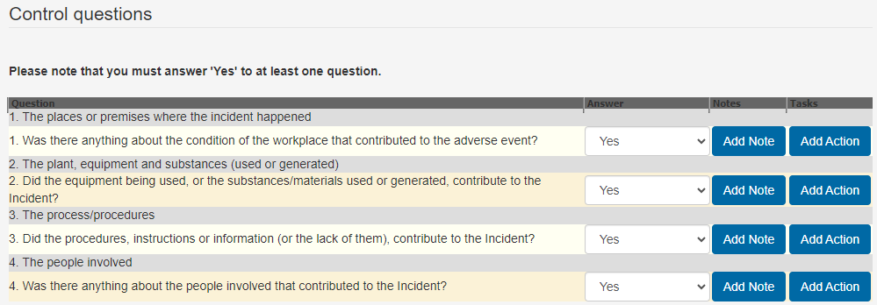
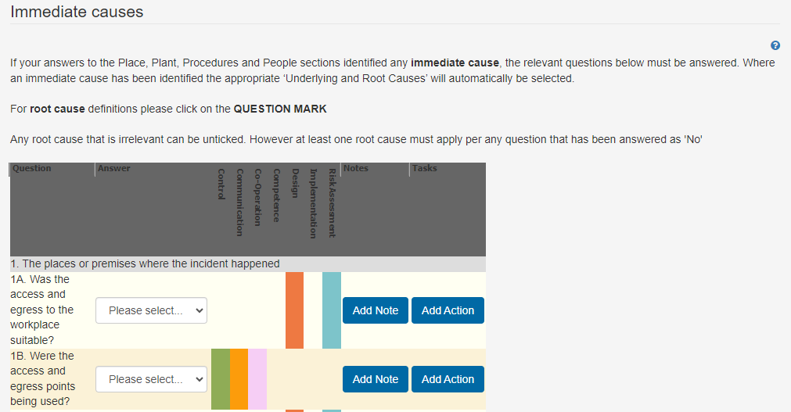
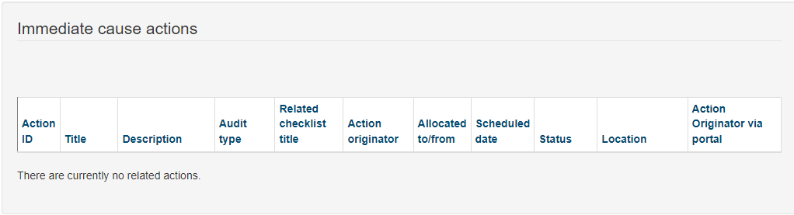
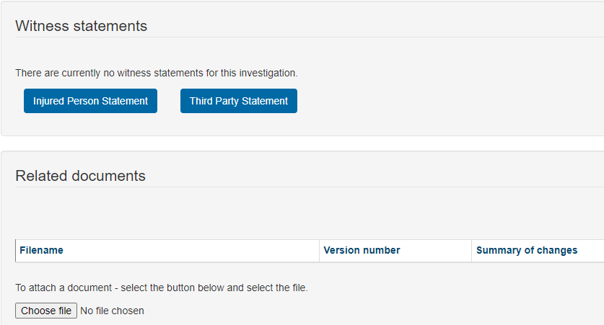
Investigation reporting
Adding investigation detail to sphera
Answer control and immediate causes questions.
Assign any immediate causes actions
Actions arising from the investigation.
Additional notes and conclusions
All documentation from the investigation, witness statements, reports, photographs in ‘Related Documents’ section.
Investigation complete – ‘yes’ – alert H&S Advisor to complete root causes analysis.

Slide 28
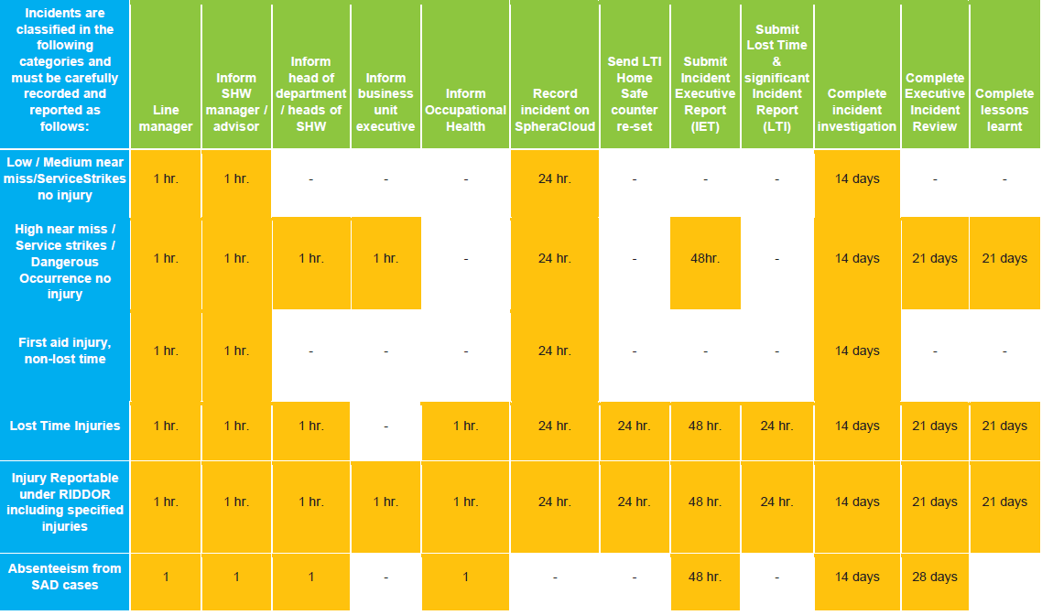
Critical Timelines for incident reporting
Timelines for investigations. (section 10 of Thameswater H&S manual)
RIDDOR and Lost Time Injuries
1hr to report through to TW H&S
24hr incident report on sphera and Homesafe counter reset
48hrs Executive Incident Report
72hr Initial Incident Review
14 days to complete investigation in sphera
21 day Executive Incident Review
High Near Miss and LV Service Strikes
1hr to report through to TW H&S.
24hr incident report on sphere
14 days investigation completed in sphera
21 day Senior Incident Review
Low/medium near miss, Non-LV Service Strikes and Non-Lost Time Injuries
1hr to report through to TW H&S
24hr incident report on sphere
4 days investigation complete in Sphera

Slide 29
Information Sources
Thameswater Health and Safety manual – section 10 managing incidents
Thameswater Health and Safety advisors
SHExx Investigation checklist

Slide 30
Summary
Incident reporting and investigation
Incident Report
Immediate information on incident
Who, where, when and what has happened.
Brief summary and actions to make safe
Not the place for the full investigation.
Investigation
Answer all immediate causes and control questions
Photographs, witness statement, timelines, POWRA and any email chains pertinent to investigation
Any actions assigned from investigation added into investigation page.
Learning bulletins and toolbox talks
Root cause analysis, in conjunction with TW H&S advisor
Timelines
Section 10 of the H&S manual.
1hr to report to H&S
72hr review for HiPO, Injuries, HV Strikes
14 days to complete and upload investigation to sphere
21 days senior incident review to close out incident.

Slide 31
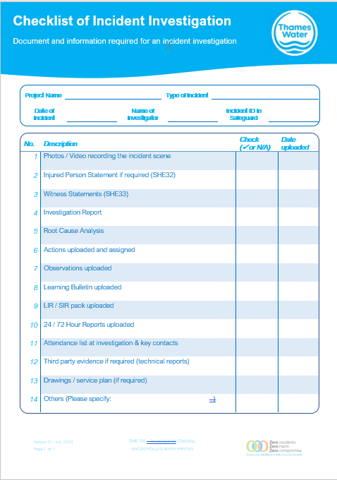
Escalation Route
Thameswater health and safety team CDEARS
Health and Safety Advisor
Matteo Pasqualone
Tom Young

Slide 32
Sphera Statistic on Service strikes

Slide 33
Sphera Statistics
CD strikes Year 3&4 to date

Slide 34
Sphera Statistics
Route Cause of Service Strikes

Slide 35
To summarise
Thank you and lets get ready to some Q&A
We have reached the end of our presentation on service strikes and our exciting new campaign aimed at raising awareness.
Through our project pride initiative, we are dedicated to elevating standards in service excellence, symbolised by our Bronze, Silver, and Gold tiers.
We have also explored the importance of accurate reporting methods and the power of statistics in tracking progress and identifying areas for improvement.
As we close, we invite you all to join us on this journey towards a higher standard of service. By supporting our campaign and embracing the principles of project pride, we can collectively make a significant impact on the quality of service in our industry.
We are now ready to move on to the Q&A session. Thank you for your attention and engagement throughout this presentation. We look forward to hearing your valuable insights and working together to bring about positive change

Slide 36
Thank you!

