Slide 1
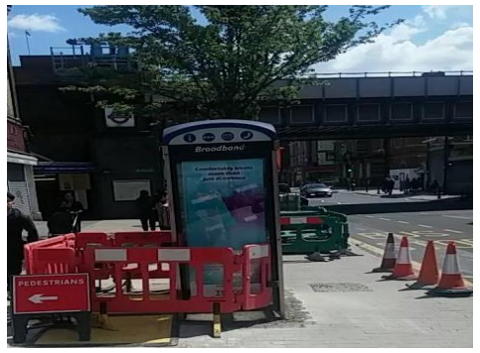
Learning Bulletin – Non Thames Water – Member of Public Fatality
What Happened?
Why did it really happen?
A dad of two fell head first into an excavation on site fatally wounding him.
The excavation site was dug up to carry out work on the water network.
The IP was walking past the site and fell into the excavation headfirst. There was no protection of the opening and did not have any signing, lighting or guarding in the place at the time of the incident to warn passers-by of the dangers or to prevent them from accessing the work area.
What can I do differently?
Ensure all excavations are covered when unattended
Always provide the required width and clear access on footways
All Heras fencing and barriers must be left secure and in accordance with Temporary Works registers
Road and pedestrian signage must be correct for the site set up and in place to clearly show road users and pedestrians what to do
If necessary use temporary lighting around the site to enchance visitbility
Always take photographs before you leave site
If you are every unsure, ALWAYS ask your supervisor before you leave site

